Slide 1

Update of the Deployment of BATS Code
Raymond W. Yeung
Institute of Network Coding
The Chinese University of Hong Kong
n-hop technologies
Hong Kong

Slide 2
Smart Lamppost Connectivity
Smart lampposts must be connected to the Internet backbone
Possible technologies
optical fiber
4G
BATS

Slide 3
Optical Fiber
Pros
very high data rate
highly reliable
Cons
high installation cost
very long setup time
very disrupting process
sometimes not possible
Realistically only a small number of lampposts can be connected by optical fiber
The rest still need to be connected to the Internet

Slide 4
How about 4G?
A 4G card is installed at each lamppost
Pros
easy to deploy
relatively inexpensive
Cons
high recurrent cost
bandwidth drops drastically during rush hours

Slide 5
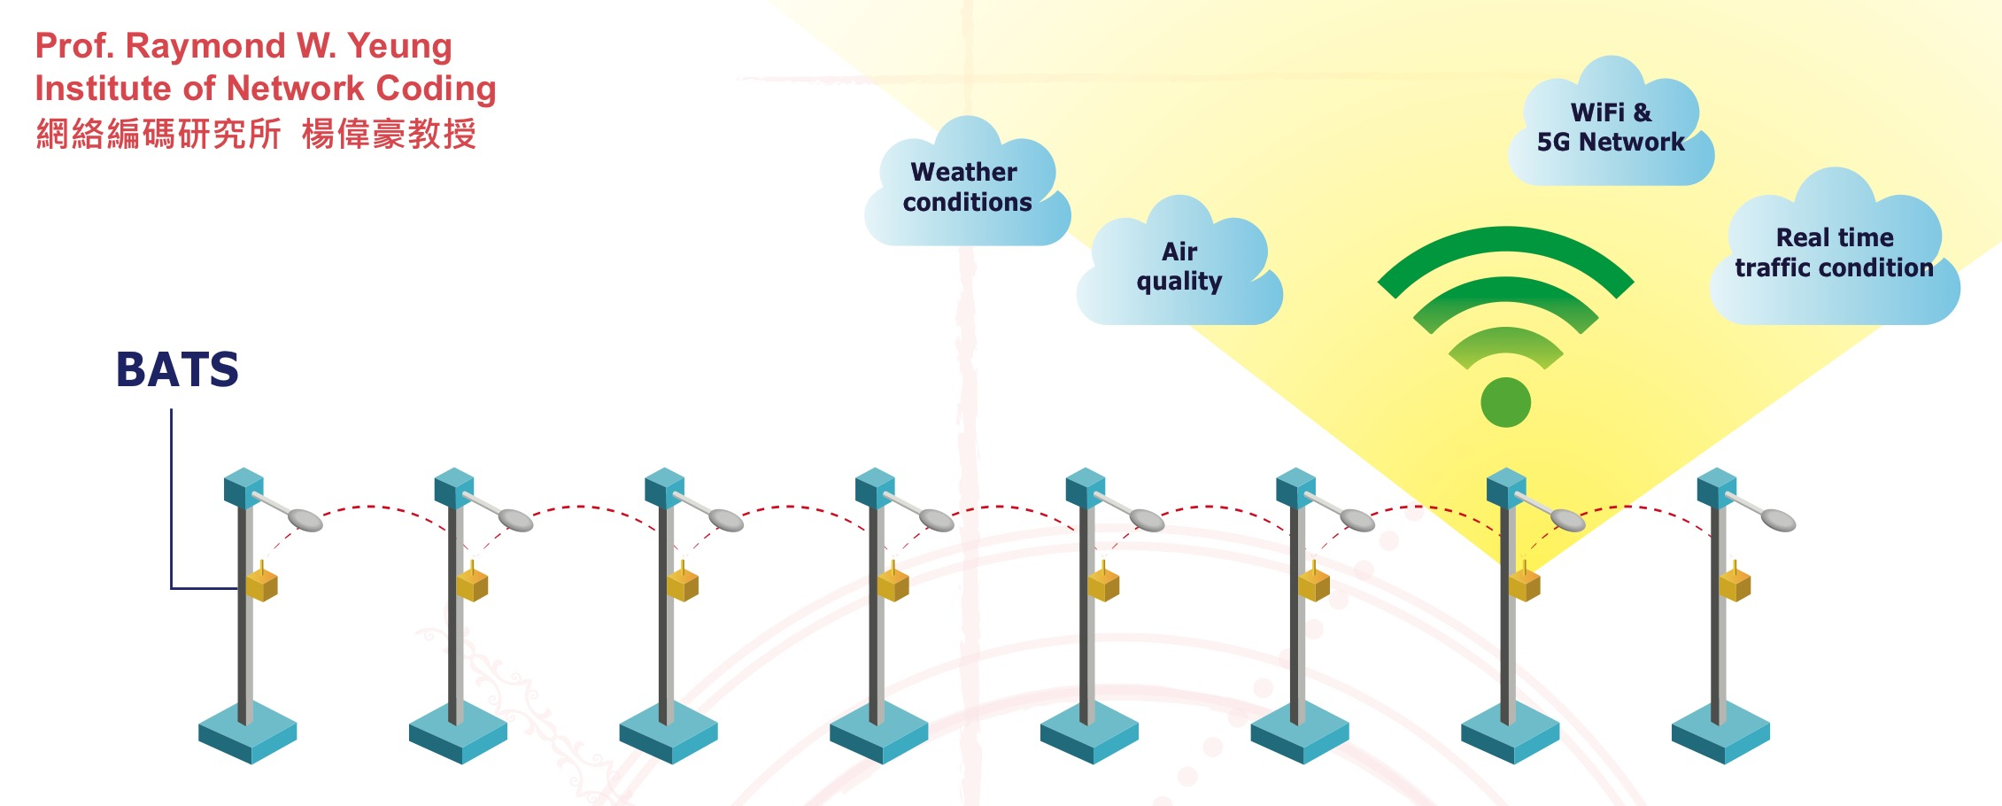
BATS: The Multi-hop Solution
optical
fiber

Slide 6
Why BATS?
Multi-hop is a longstanding problem in wireless communication
Transmission can sustain no more than a few hops if data packets are treated as commodities
The multi-hop curse
BATS is an advanced network coding technology that can sustain tens or even hundreds of hops, without relying on link-by-link retransmission (very bad for video transmission)
Recoding is employed at the intermediate nodes
With BATS, a very long multi-hop network can be realized

Slide 8
Performance Comparison

Slide 9
Performance Comparison

Slide 10
Technical Features
high throughput
low latency
low coding complexity
low storage requirement
☑
☑
☑
☑

Slide 11
Hong Kong Smart Lamppost Project

Slide 12
Pilot Project
Installation of 400 smart lampposts starting summer 2019
Followed by several 10,000 lampposts
n-hop has been commissioned to deploy BATS in 36 out of the first 50 smart lampposts

Slide 13




Slide 14



Participated in the 47th International Exhibition of Inventions of Geneva, 2019:
“Wireless Multi-hop Network for Smart Lampposts”
Awarded a Gold Medal with Congratulations of the Jury

Slide 15

co-developed with
Photo for reference only

Slide 16
Current Status
Successfully deployed at two streets
one street heavily vandalized during a protest on 8/24
Almost done at another street
The general public has concern about the installation of video cameras on the lampposts due to possible infringement of privacy
The Government has formed a special committee to review the smart lampposts applications
One possible recommendation is to replace the cameras by radars or lidars

Slide 17
BATS + Fog Computing
BATS is inherently a fog computing application because the computation must be done at the edge
Plan to install 20 fog computing based smart lampposts on the CUHK campus, with BATS being provided as a service by the fog node
A prototype for next generation smart lampposts

Slide 18
Further Opportunities
The HK Government is interested in installing smart lampposts in the country parks (largely not covered by celluar) for providing WiFi services to hikers
Many cities in Southeast Asia are interested in pilot smart lamppost projects

Slide 19
Internet Draft Submitted
BATS Coding Scheme for Multi-hop Data Transport
draft-yang-nwcrg-bats-00 (Oct 21, 2018)
Prepared by
Shenghao Yang, Xuan Huang
The Chinese University of Hong Kong, Shenzhen
Raymond W. Yeung
The Chinese University of Hong Kong
John K. Zao
National Chiao Tung University

Slide 20
BATS IPs
3 US patents
US Patent No. 8,693,501
US Patent Application No. 14/871,257
US Patent No. 10,237,782
6 EU patents
DE validation of EP Patent No. 2644004
FI validation of EP Patent No. 2644004
FR validation of EP Patent No. 2644004
GB validation of EP Patent No. 2644004
SE validation of EP Patent No. 2644004
2 China patents
CN Patent No. ZL 201180055775.3
CN Patent Application no. 201610857698.8

Slide 21
The BATS solution
optical
fiber

